Slide 1
Salaries Analysis for Data Roles
2020 - 2023

Slide 2
Topic
Data roles - trends & salaries
Why? - It is a subject of considerable interest and we wish to investigate it further.
Describe
Dataset
The original dataset: 3755 rows & 13 columns.
year
experience_level
employment_type
job_title
salary
remote_ratio
country
Structure & process
Pull Data Clean Data Format Data Merge Data

Slide 3
Hypothesis:
Medium size companies pay high average.
Medium size companies hire more senior level.
Inflation has a direct impact on employees salaries

Slide 4
Data Wrangling and Cleaning
We encountered missing data, required date formatting, mismatched country names in the column headers, and inconsistent data types.
With the help of APIs, we enriched our dataset by adding inflation data for comparison with salaries.
Merging the data was challenging due to the use of different APIs for eight countries, requiring a focused effort to match data types.
Exploratory Data Analysis
We utilized Python libraries including Pandas, NumPy, Matplotlib, Seaborn, and Plotly

Slide 5
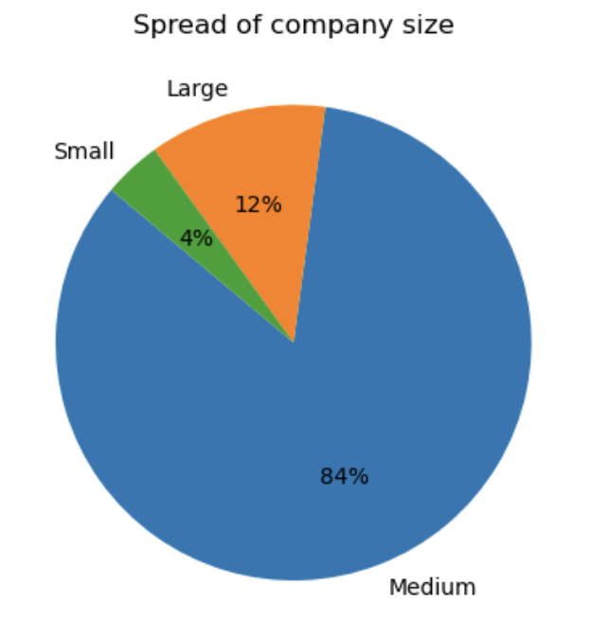
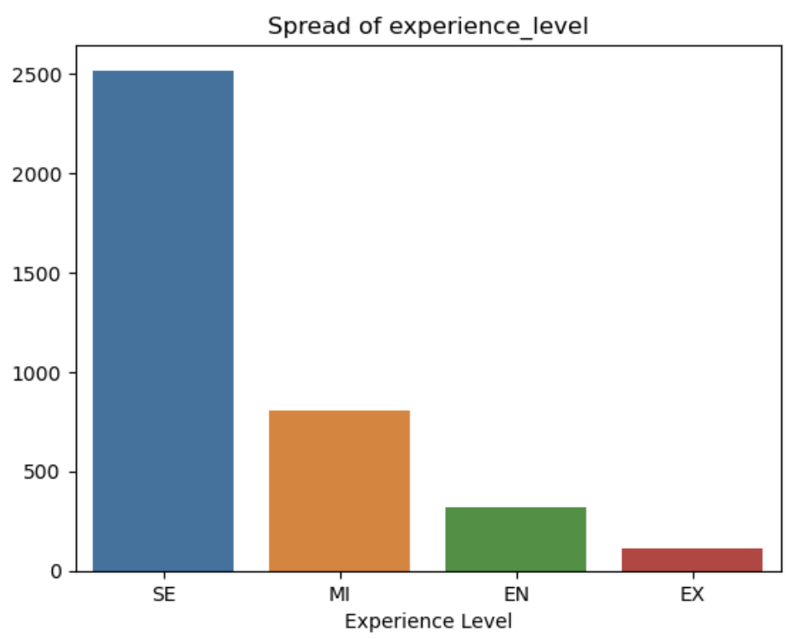
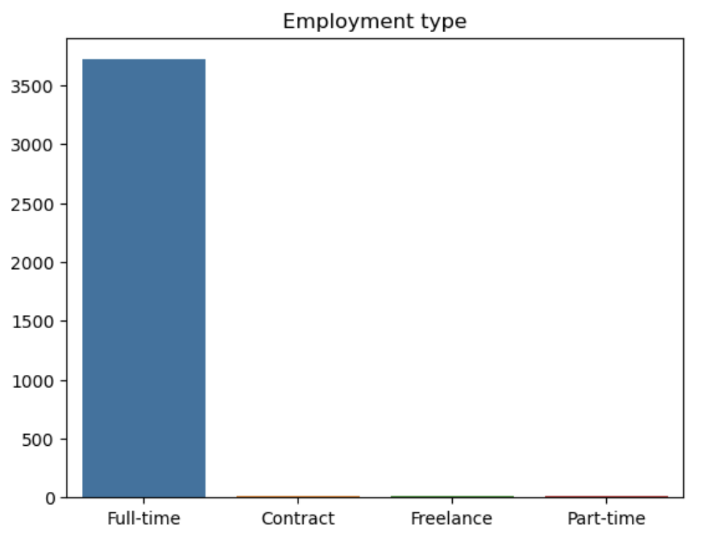
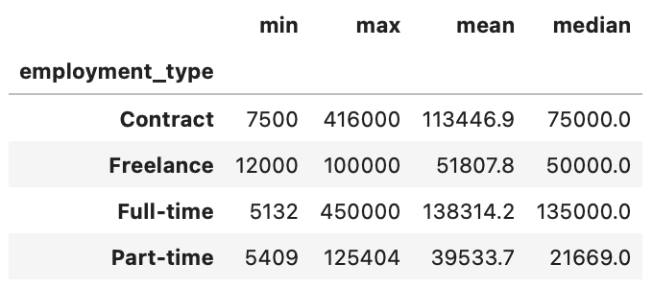
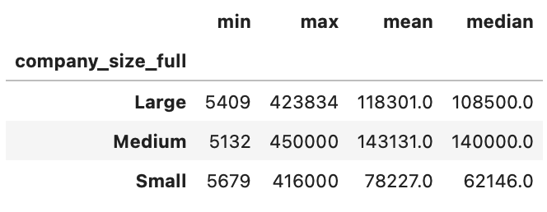
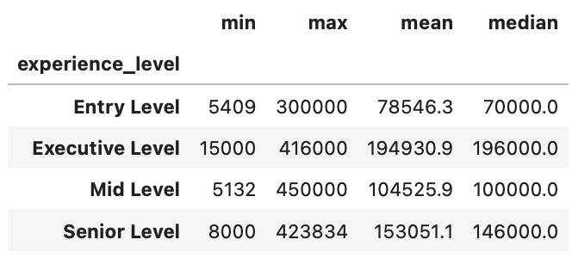

Slide 6
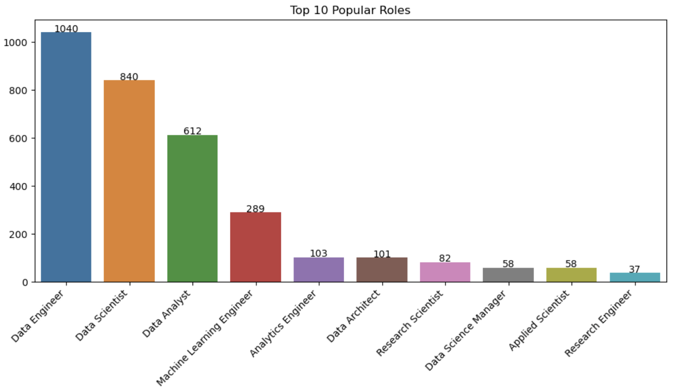
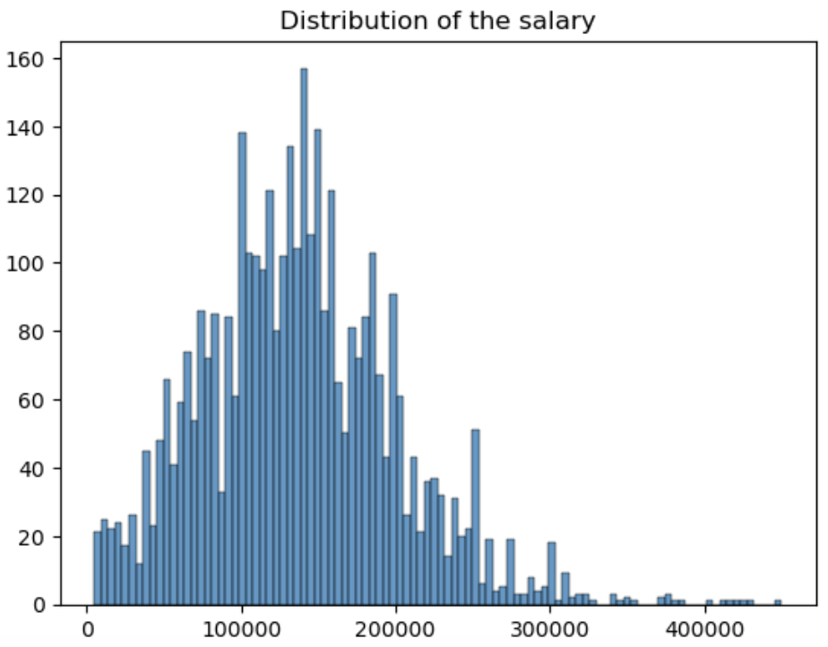
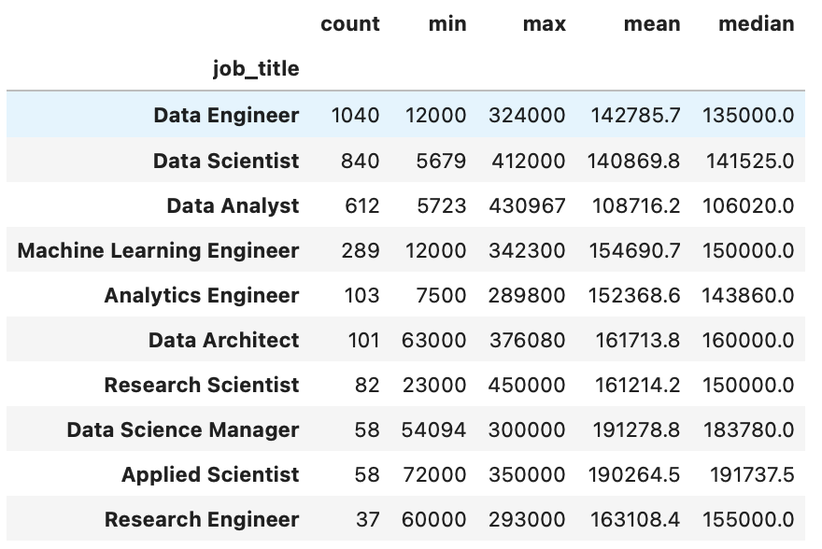

Slide 7
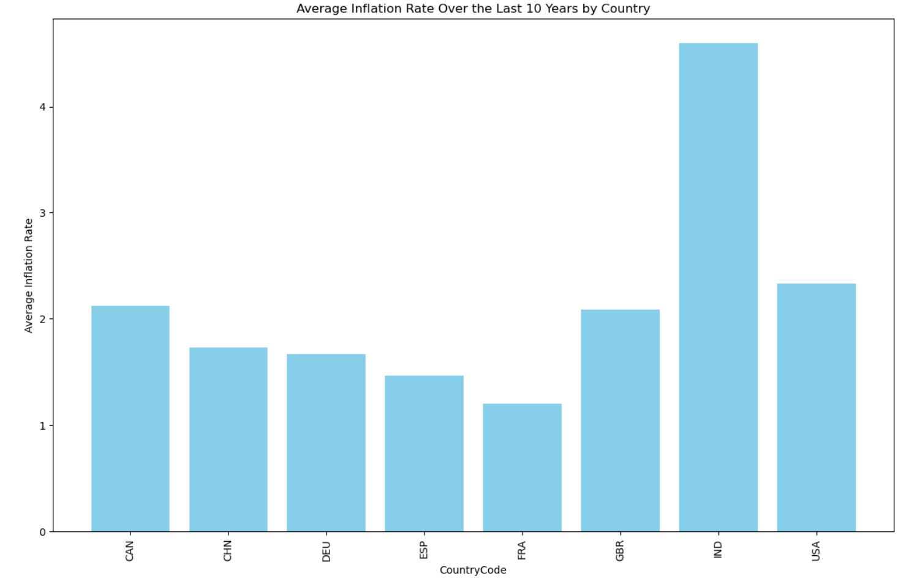
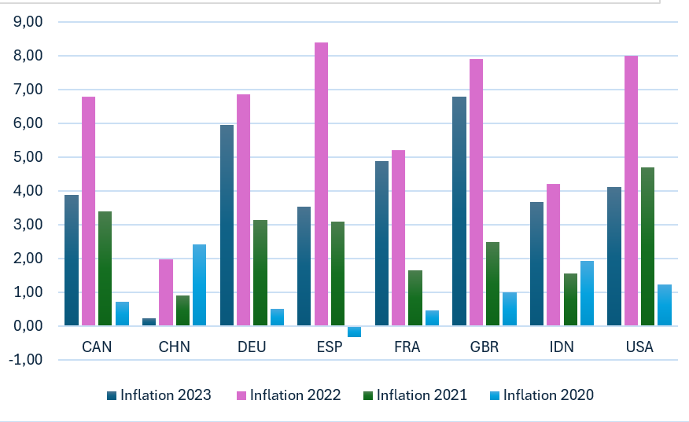
Avg inflation for 10 year
Inflation for 2021-2023 year

Slide 8
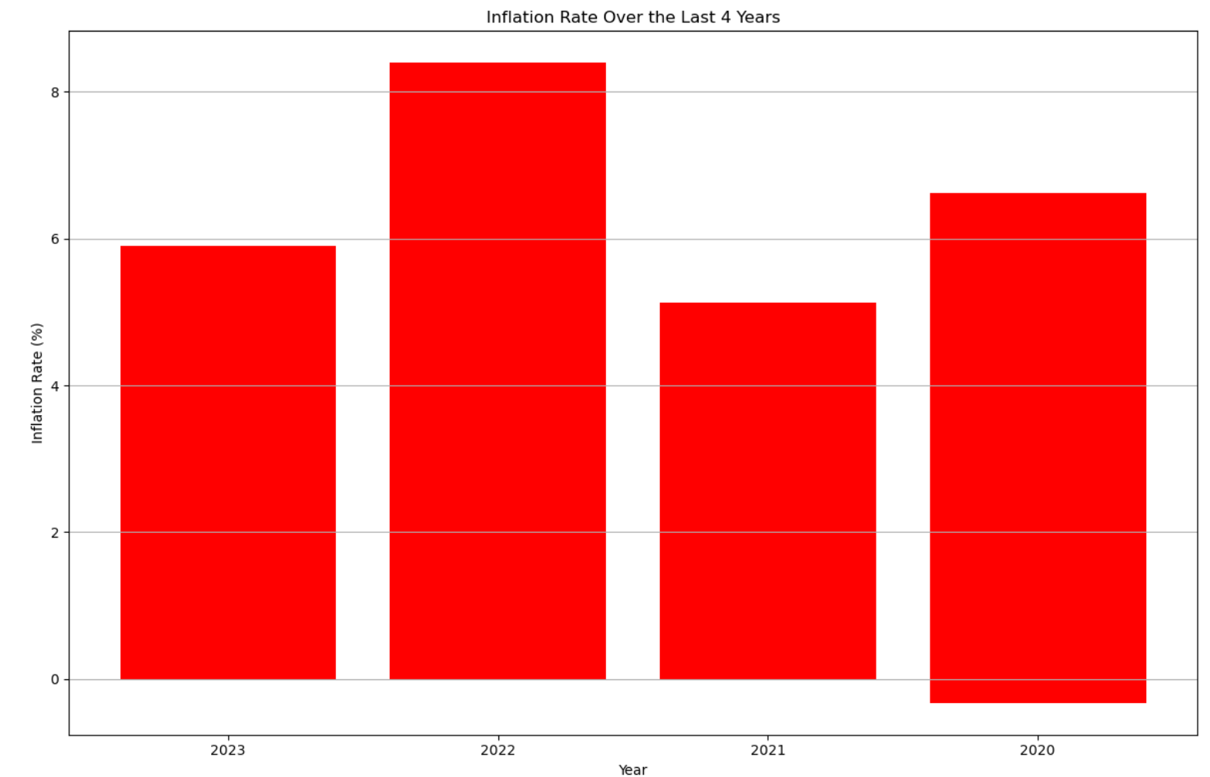
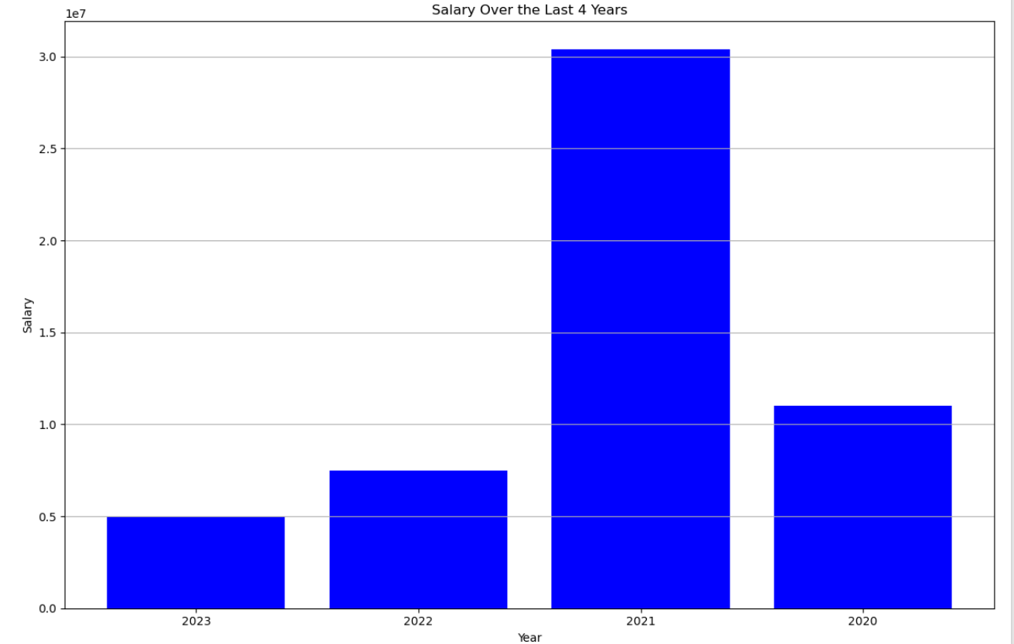
“Inflation has a direct relation with employees salaries”

Slide 9
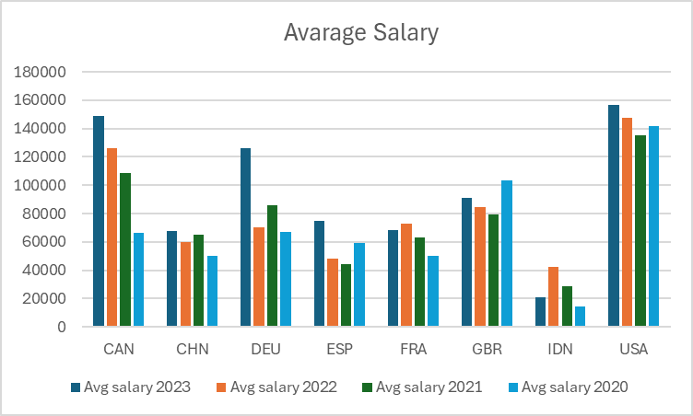
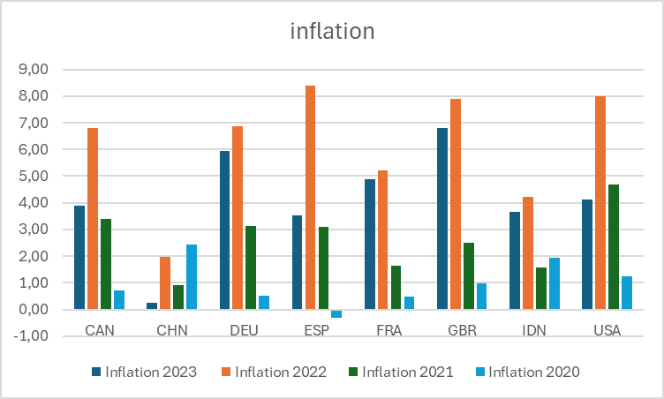

Slide 10
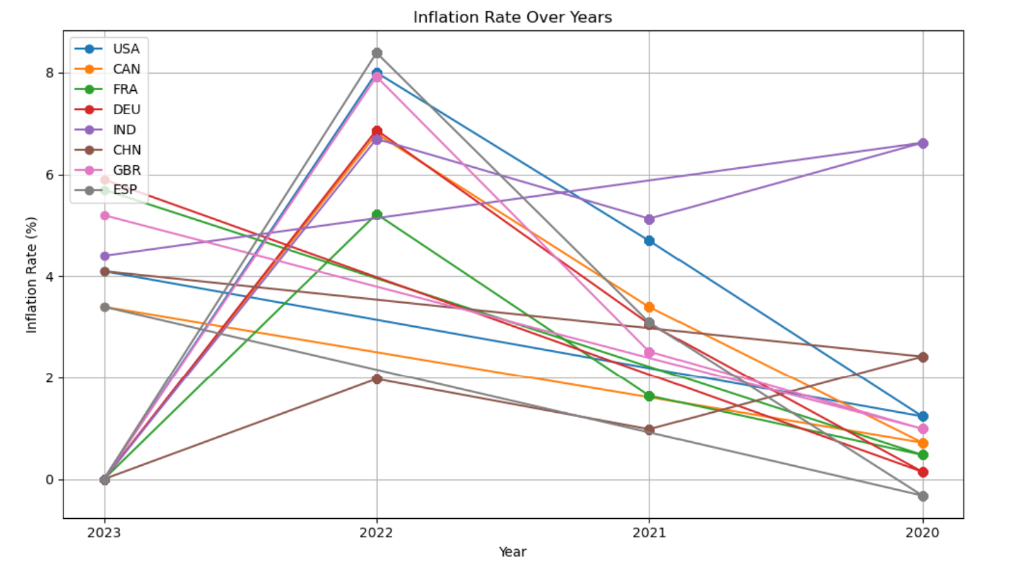
Inflation Rate Over 4 years

Slide 11
Teamwork & Project Management
We followed a structured workflow from the beginning of the project.
We worked as a team with excellent communication and coordination. As an improvement, we can aim to tackle a more complex dataset next project.
Risk: We encountered a challenge when we were unable to find a suitable API for two days. During this period, we considered changing the project, which could have resulted in a two-day setback

Slide 12
Conclusion
The disparities in inflation and salary trends between countries underscore the need for tailored economic strategies. While some countries have managed to keep inflation rates low and stable, others face challenges that require targeted interventions to protect the financial well-being of their workforce.

Slide 13

Thank You!!
Salaries Analysis for Data Roles 2020-23
Anca & Savi.

